Slide 1
Introduction to Software Development
Kirill Korolev
05.04.2021

Slide 2
Agenda
Motivation
VCS
Code style
Testing
CI
TDD

Slide 3
Motivation
The key difference of industrial code – it’s large!
Very complex programs for solving a wide range of tasks
Gets even larger over time
The following issues arise:
How to write readable code?
How to write easy-to-modify code?
How to make everyone to write similar code?
How to synchronize many developers?
How to write reliable code?
Code style
VCS
Unit testing / CI / TDD

Slide 4
VCS - Version Control System

Slide 5
Repository
is the main Git object
There are 2 ways to look at a repository:
Workspace – a file directory of your project
A database of changes made in the project
Git repository is a combination of 2 visions

Slide 6
Changes
git operates with per-line changes in files instead of whole files:
diff --git a/simulator/config.cpp b/simulator/config.cpp
index 55737c..d9855ab 10064
---a/simulator/config.cpp
+++b/simulator/config.cpp
@@ -13,7 +13,7 @@ namespace config {
static AliasedSwitch help_option = { “h”, “help”, “print help” };
/* basic method */
-void handleArgs( int argc, const char* argv[])
+void handleArgs( int argc, const char* const argv[])
{
BaseValue::options().parse( argc, argv);

Slide 7
Commit
is a group of changes with metadata
Represents a workspace state
Each commit includes:
a pointer to the previous commit
a description
author’s name and e-mail
an unique hash (e. g. 23fdc78f...)
Merge is a commit with 2 ‘parents’
+++
---
+++
---

Slide 8
Commit tree & refs
repository
master
All commits compose a commit tree
Some commits a labeled by refs
master points to the latest main version of the project
HEAD points to the current workspace state
workspace + commit tree + refs = git repository
+++
---
+++
---
+++
---
+++
---
+++
---
+++
---
HEAD
subproj1

Slide 9
Changes states
Untracked exist only in workspace
Unmodified
same in workspace and commit tree
git rm
git add
git commit
<text editor name here>
Staged
Modified different in workspace and commit tree
git add

Slide 10
How to work with the repository
merge conflict!
5 basic steps:
Update your local repository
Make your changes
Choose changes for a commit
Create a new commit
Send your commits to original repository
Steps 2-3 happens locally
Local and remote changes can conflict
a local copy of the original repository
1. git pull
2. make your changes
the original remote repository
3. git add [file1, file2...]
4. git commit –m “...”
5. git push

Slide 11
Work flow
GitHub
local machine
create
a copy of the main repository on Github
create
a copy of the main repository on your local machine
fork
git clone
the main repository on GitHub
update
update
pull request
git push
update
git pull

Slide 12
Code style

Slide 13
Why good code is important?
Bad code is:
hard to read and understand
hard to change
easy to broke
A programmer spent most of the time with code, reading, writing and debugging it
Bad code makes programmers spend much more time on these things
A programmer should not optimize CPU time, only programmer’s time

Slide 14
Naming rules
Names are the largest part of code
We are constantly creating new names in our programs
int main( int argc, const char* argv[]) try {
config::handleArgs( argc, argv, 1);
ElfLoader elf( config::binary_filename);
auto memory = FuncMemory::create_hierarchied_memory();
elf.load_to( memory.get());
auto sim = Simulator::create_configured_simulator();
sim->set_memory( memory);
sim->init_checker();
sim->set_pc( elf.get_startPC());
sim->run( config::num_steps);
int main( int argc, const char* argv[]) try {
config::handleArgs( argc, argv, 1);
ElfLoader elf( config::binary_filename);
auto memory = FuncMemory::create_hierarchied_memory();
elf.load_to( memory.get());
auto sim = Simulator::create_configured_simulator();
sim->set_memory( memory);
sim->init_checker();
sim->set_pc( elf.get_startPC());
sim->run( config::num_steps);

Slide 15
Name rule #1
Name should reveal original intention
The name is bad, if:
it needs a comment
you need to read code to understand its purpose
void add(int * const a, int * const b) {
int i = 0, t = -1;
for (i = MAX_D; i >= 0; i--) {
if (b[i] == 0) continue;
t = a[i] + b[i];
if (i != 0) {
a[i - 1] += t / 10;
a[i] = t % 10;
} else
a[i] = t;
}
}
size_t s; // array size
size_t array_size;

Slide 16
Name rule #2
Avoid disinformation
Change a name along with code meaning

Slide 17
Name rule #3
Use right parts of speech
Nouns for objects, verbs for methods
template <typename ISA>
void Fetch<ISA>::save_flush( Cycle cycle)
{
/* save PC in the case of flush signal */
if( rp_flush_target->is_ready( cycle))
wp_target->write( rp_flush_target->read( cycle), cycle);
else if( rp_target->is_ready( cycle))
wp_target->write( rp_target->read( cycle), cycle);
}

Slide 18
Names length rules: variables
Short if scale is short
Long if scale is long
std::string PlainMemory::dump() const
{
std::ostringstream oss;
oss << std::setfill( '0') << std::hex;
for ( auto it = arena.begin(); it != arena.end(); ++it)
if ( uint32( *it) != 0)
oss << "addr 0x" << std::distance(arena.begin(), it)
<< ": data 0x" << uint32( *it) << std::endl;
return oss.str();
}

Slide 19
Name length rules: functions
Short for public and frequently used
Long for private or rarely used
std::shared_ptr<Simulator> Simulator::create_configured_simulator()
template<typename T, Endian endian> T FuncMemory::read( Addr addr) const

Slide 20
Length: check rule
If your cannot think of a meaningful function/class name, it is likely too large
const uint64 MAX_NOPS_IN_A_ROW = 10;
template <typename ISA>
void FuncSim<ISA>::update_nop_counter( const typename FuncSim<ISA>::FuncInstr& instr)
{
if ( instr.is_nop())
++nops_in_a_row;
else
nops_in_a_row = 0;
check_nop_counter();
}
template <typename ISA>
void FuncSim<ISA>::check_nop_counter()
{
if (nops_in_a_row > MAX_NOPS_IN_A_ROW)
throw BearingLost();
}
template <typename ISA>
void FuncSim<ISA>::update_nop_counter( const typename FuncSim<ISA>::FuncInstr& instr)
{
if ( instr.is_nop())
++nops_in_a_row;
else
nops_in_a_row = 0;
check_nop_counter();
}
template <typename ISA>
void FuncSim<ISA>::check_nop_counter()
{
if (nops_in_a_row > 10)
throw BearingLost();
}
template <typename ISA>
void FuncSim<ISA>::update_and_check_nop_counter( const typename FuncSim<ISA>::FuncInstr& instr)
{
if ( instr.is_nop())
++nops_in_a_row;
else
nops_in_a_row = 0;
if (nops_in_a_row > 10)
throw BearingLost();
}

Slide 21
Function size rule
Keep functions small
Small functions are easy to read, understand and navigate through
template<typename RegisterUInt>
void BaseMIPSInstr<RegisterUInt>::init( const BaseMIPSInstr<RegisterUInt>::ISAEntry& entry, MIPSVersion version)
{
operation = entry.operation;
mem_size = entry.mem_size;
function = entry.versions.is_supported(version)
? entry.function
: &BaseMIPSInstr<RegisterUInt>::execute_unknown;
shamt = instr.asR.shamt;
src1 = get_register( entry.src1);
src2 = get_register( entry.src2);
dst = get_register( entry.dst);
if ( entry.dst == RegType::HI_LO)
dst2 = MIPSRegister::mips_hi;
const bool print_dst = is_explicit_register( entry.dst);
const bool print_src1 = is_explicit_register( entry.src1);
const bool print_src2 = is_explicit_register( entry.src2);
std::ostringstream oss;
if ( PC != 0)
oss << std::hex << "0x" << PC << ": ";
oss << entry.name;
switch ( operation)
{
case OUT_R_SHAMT:
oss << " $" << dst
<< ", $" << src1
<< ", " << std::dec << shamt;
break;
case OUT_I_ARITHM:
v_imm = instr.asI.imm;
oss << " $" << dst << ", $"
<< src1 << ", "
<< std::hex << "0x" << v_imm << std::dec;
break;
case OUT_I_BRANCH:
v_imm = instr.asI.imm;
oss << " $" << src1 << ", $"
<< src2 << ", "
<< std::dec << static_cast<int16>(v_imm);
break;
case OUT_RI_BRANCH_0:
v_imm = instr.asI.imm;
oss << " $" << src1 << ", "
<< std::dec << static_cast<int16>(v_imm);
break;
case OUT_RI_TRAP:
v_imm = instr.asI.imm;
oss << " $" << src1 << ", 0x"
<< std::hex << static_cast<int16>(v_imm) << std::dec;
break;
case OUT_I_CONST:
v_imm = instr.asI.imm;
oss << " $" << dst << std::hex
<< ", 0x" << v_imm << std::dec;
break;
case OUT_I_LOAD:
case OUT_I_LOADU:
case OUT_I_PARTIAL_LOAD:
v_imm = instr.asI.imm;
oss << " $" << dst << ", 0x"
<< std::hex << v_imm
<< "($" << src1 << ")" << std::dec;
break;
case OUT_I_STORE:
v_imm = instr.asI.imm;
oss << " $" << src2 << ", 0x"
<< std::hex << v_imm
<< "($" << src1 << ")" << std::dec;
break;
case OUT_J_JUMP:
v_imm = instr.asJ.imm;
oss << " 0x" << std::hex << v_imm << std::dec;
break;
default:
if (print_dst) {
oss << " $" << dst;
if (print_src1)
oss << ",";
}
if (print_src1)
oss << " $" << src1;
if (print_src2)
oss << ", $" << src2;
break;
}
if ( instr.raw == 0x0ul)
disasm = "nop ";
else
disasm = oss.str();
}
template <typename ISA>
typename Decode<ISA>::Instr Decode<ISA>::read_instr( Cycle cycle)
{
if ( rp_stall_datapath->is_ready( cycle))
return rp_stall_datapath->read( cycle);
return rp_datapath->read( cycle);
}

Slide 22
Function size: check rule
int main( int argc, const char* argv[]) try {
config::handleArgs( argc, argv, 1);
ElfLoader elf( config::binary_filename);
auto memory = FuncMemory::create_hierarchied_memory();
elf.load_to( memory.get());
auto sim = Simulator::create_configured_simulator();
sim->set_memory( memory);
sim->init_checker();
sim->set_pc( elf.get_startPC());
sim->run( config::num_steps);
auto kernel = Kernel::create_kernel();
kernel->set_memory( memory);
kernel->set_simulator( sim);
sim->set_kernel( kernel);
return 0;
}
int main( int argc, const char* argv[]) try {
config::handleArgs( argc, argv, 1);
ElfLoader elf( config::binary_filename);
auto memory = FuncMemory::create_hierarchied_memory();
elf.load_to( memory.get());
auto sim = Simulator::create_configured_simulator();
sim->set_memory( memory);
sim->init_checker();
sim->set_pc( elf.get_startPC());
sim->run( config::num_steps);
auto kernel = Kernel::create_kernel();
kernel->set_memory( memory);
kernel->set_simulator( sim);
sim->set_kernel( kernel);
return 0;
}
A function does ONE thing
If not, split the function into smaller ones
If new functions use common data, combine them into a class

Slide 23
Code style guidelines
template <typename ISA>
void Fetch<ISA>::clock_instr_cache(Cycle cycle){
if(rp_long_latency_pc_holder->is_ready(cycle)){
auto target=rp_long_latency_pc_holder->read(cycle);
tags->write(target.address);
wp_hold_pc->write(target, cycle);
return;}
wp_hit_or_miss->write(false, cycle);
}
An easy way to make code more readable
One style to code them all!
Multiple people always work with one code
Choose one style and use it everywhere in project
Keep code lines short
A code line should fit the screen
template <typename ISA>
void Fetch<ISA>::clock_instr_cache( Cycle cycle)
{
if( rp_long_latency_pc_holder->is_ready( cycle))
{
auto target = rp_long_latency_pc_holder->read( cycle);
tags->write( target.address);
wp_hold_pc->write( target, cycle);
return;
}
wp_hit_or_miss->write( false, cycle);
}

Slide 24
Comments rules
template <typename ISA>
typename FuncSim<ISA>::FuncInstr FuncSim<ISA>::step()
{
// fetch instruction
FuncInstr instr = imem.fetch_instr( PC);
// set sequence_id
instr.set_sequence_id(sequence_id);
sequence_id++;
// read sources
rf.read_sources( &instr);
// execute
instr.execute();
...
Avoid comments if you can
Code should explain itself
Remember name rule!
Comment should add new information
template <typename ISA>
typename FuncSim<ISA>::FuncInstr FuncSim<ISA>::step()
{
FuncInstr instr = imem.fetch_instr( PC);
instr.set_sequence_id(sequence_id);
sequence_id++;
rf.read_sources( &instr);
instr.execute();
...

Slide 25
Unit Testing

Slide 26
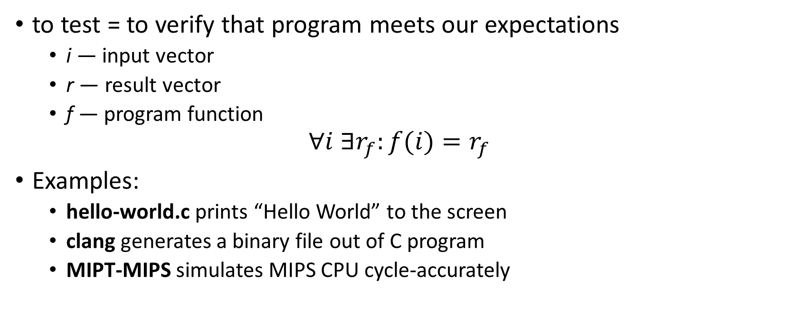
What is testing?
to test = to verify that program meets our expectations
i — input vector
r — result vector
f — program function
$$∀i ∃r_{f}:f(i){=r}_{f}$$
Examples:
hello-world.c prints “Hello World” to the screen
clang generates a binary file out of C program
MIPT-MIPS simulates MIPS CPU cycle-accurately

Slide 27
Units and unit tests
What is a unit?
Functional programming: a function
OOP: a class and its methods
Why testing units is better?
Easier to debug
Tests run faster
Test case — a single input and a single output
Test suite — a set of test cases for a unit

Slide 28
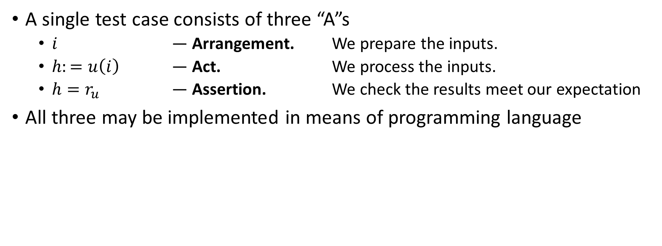
Three A rule
A single test case consists of three “A”s
$i$ — Arrangement. We prepare the inputs.
$h:=u\left(i\right)$ — Act. We process the inputs.
$h=r_{u}$ — Assertion. We check the results meet our expectation
All three may be implemented in means of programming language

Slide 29
Unit tests benefits
Safe refactoring
Can class/function as long as its test suite passes
Motivates structured code
Unit tests require... units – isolated modules with clear interface
Formal agreement with customers/other developers
A test suite contains everything that a unit does
As long as the test suite passes, the unit works 100% correctly

Slide 30
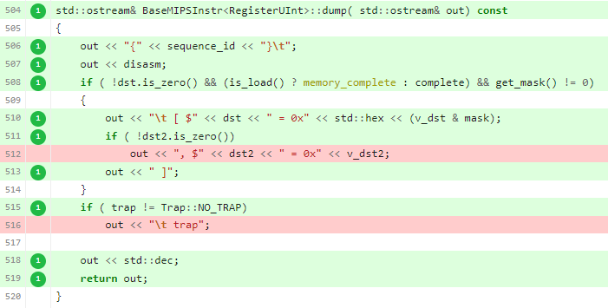
Code coverage
Code coverage system shows control flows never triggered by any test
Highlights unit functionality without a test
A full test suite has 100% coverage of unit code
Drawback: no guarantee that each control flow combination is possible

Slide 31
Continuous Integration
Problem:
More time feature development takes – more time it will take to merge the ready feature into the project main branch
Solution – CI:
An automated system which for every version of the development branch:
Build the project
Runs tests
Checks merging with “master”
Makes integration faster while keeping “master” stable.

Slide 32
TDD – Test-Driven Development

Slide 33
What is TDD?
Common approach to unit testing: write a program first, then cover it with unit tests to fix bugs and optimize
TDD = Test Driven Development – a more advanced programming technique: write tests first, then write code to make the tests pass

Slide 34
Three ground rules of TDD
Rule #1: Do not write code until you have a failing unit test
Rule #2: Stop writing tests when you have a failing unit test
Rule #3: Write code only enough to make the failing test pass
These rules form a cycle with each iteration a couple minutes long

Slide 35
TDD advantages
Without TDD (writing tests AFTER code)
Design the entire program at once
The program works only in the very end of development
Possible suboptimal or untestable program design
With TDD (writing tests BEFORE code)
Always focus only on a tiny part of functionality
A working program after each TDD iteration
Optimal well-structured design
100% test coverage
Well-organized development process

Slide 36
TDD disadvantages
Successful TDD practice requires experience and self-discipline
High overhead in case of flow errors

Slide 37
TDD guidelines
TDD development is separated in short iterations (2-3 minutes long)
Each iteration consists of 3 steps:
BREAK: write a failing unit test
Remember the Rule #2: Stop writing tests, when you have a failing unit test
FIX: write code to make the test pass
Remember the Rule #3: Write code only to make a failing test pass
REFACTOR: restructure code and remove duplicates

Slide 38
TDD rule of convergence
When tests become more specific, code becomes more general
Correct TDD makes the program write itself
ASSERT_EQ(f(2), 2);
ASSERT_EQ(f(2), 2);
ASSERT_EQ(f(0), 1);
ASSERT_EQ(f(1), 1);
ASSERT_EQ(f(3), 6);
ASSERT_EQ(f(4), 24);
ASSERT_EQ(f(5),120);
int f(int arg) {
int result = 1;
for (int i = 2; i <= arg; i++)
result *= i;
return result;
}
int f(int arg) {
return 2;
}

Slide 39
How to choose unit tests?
Unit test order - the most important part of TDD approach
Start with the simplest the most degenerate unit tests, e. g. corner cases, invalid cases...
Move towards more complex test cases as slow as possible
Self-check: each new unit test should require just a couple of changed code lines
If you jump to complex test cases too fast, you stuck
It takes to finish almost the whole program to make the unit test pass
The only solution is to restart TDD flow from very beginning

Slide 40
References

Slide 41
VCS
GitHub repository: https://github.com/MIPT-ILab/mipt-mips
GitHub Wiki: https://github.com/MIPT-ILab/mipt-mips/wiki
Git main page: https://git-scm.com/
Documentation, tutorials, cheat sheets: https://git-scm.com/doc
Downloads: https://git-scm.com/downloads
Pro Git book (EN/RU): https://git-scm.com/book/en/v2
Git flight rules (EN/RU): https://github.com/k88hudson/git-flight-rules

Slide 42
Code style
Martin, Robert C. (2009). Clean Code: A Handbook of Agile Software Craftsmanship. Upper Saddle River, NJ: Prentice Hall. ISBN 9780132350884.
“Clean Code” video: https://cleancoders.com/episode/clean-code-episode-1/show
MIPT-MIPS Wiki page: https://github.com/MIPT-ILab/mipt-mips/wiki/Code-style-guidelines
MIPT-MIPS code style: https://github.com/MIPT-ILab/mipt-vis/wiki/CodingStyle

Slide 43
Unit tests
Wiki: https://github.com/MIPT-ILab/mipt-mips/wiki/Unit-Tests
CATCH2 tutorial: https://github.com/catchorg/Catch2/blob/master/docs/tutorial.md#top

Slide 44
TDD
Martin, Robert C. (2009). Clean Code: A Handbook of Agile Software Craftsmanship.
Koskela, Lesse (2007) Test Driven: Practical TDD and Acceptance TDD for Java Developers
Wiki note: https://github.com/MIPT-ILab/mipt-mips/wiki/Introduction-to-Test-Driven-Development

